Slide 1
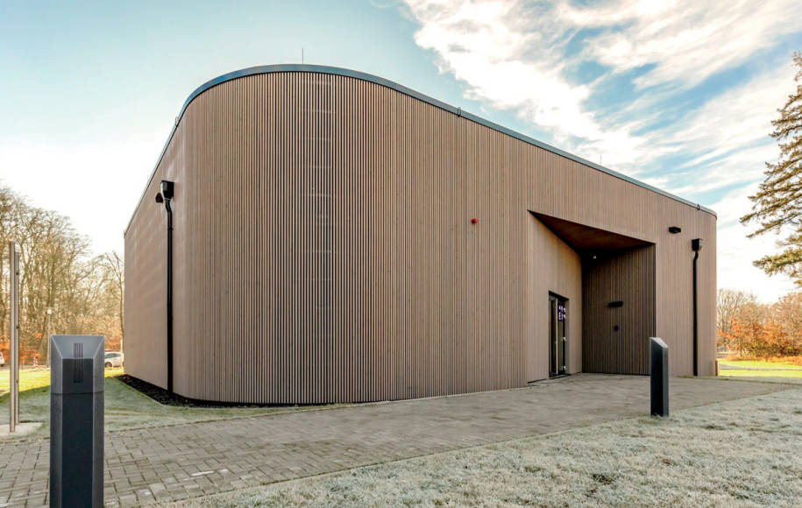
Quantum computing for Earth Observation
computerworld.ch
M2GARSS 2024 - Tutorial
April 15, 2024 Amer Delilbasic, Gabriele Cavallaro

Slide 2
Driving questions for the tutorial
What is quantum computing?
Why the quantum computing hype?
How can Earth observation benefit from quantum computing?
Which algorithms and resources are relevant for me?

Slide 3

Tutorial structure
Part 1: Introduction
Quantum computing
Quantum optimization
Quantum machine learning
Part 2: Examples
Acquisition planning for
EO satellites

Slide 4
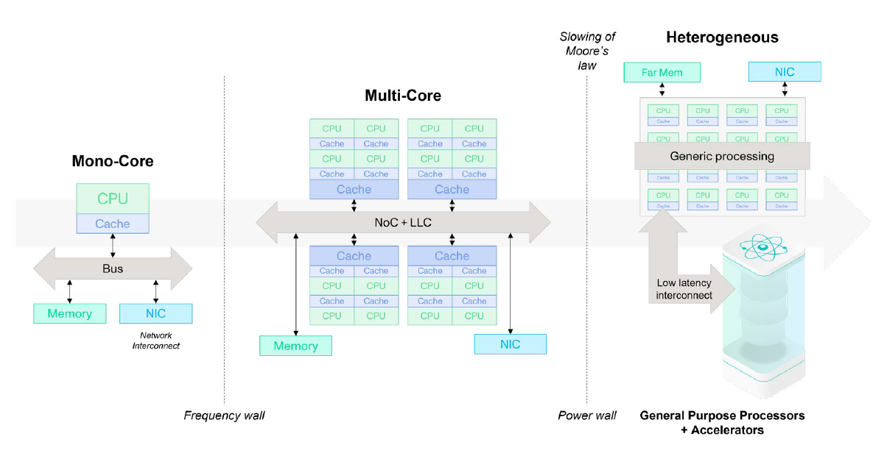
Evolution of computing architectures
IQM – LRZ, “Bringing quantum acceleration to Supercomputers”, whitepaper, May 2022

Slide 5
Principles of quantum mechanics
Quantum computing is defined according to the postulates and laws of quantum mechanics.
Underlying concepts:
Superposition
Quantum systems can be described as a superposition of quantum states
Measurement
Measuring the state of a quantum system affects the state of the system in a random way
Entanglement
In an entangled system, the states of the system particles are related to each other

Slide 6
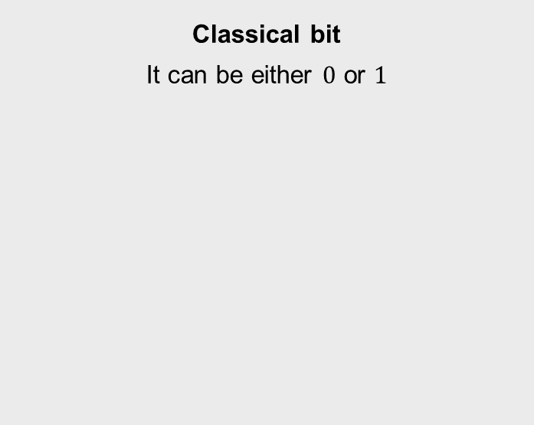
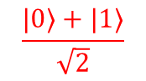
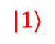
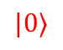
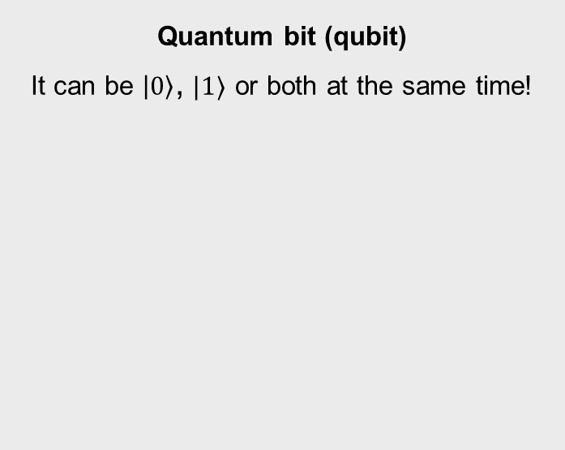
Qubit as information unit
Classical bit
It can be either $0$ or $1$
Quantum bit (qubit)
It can be $\left|0\right\rangle$, $|1⟩$ or both at the same time!
$$|0⟩$$
0 | 1 | 0 | 0 | 1 | 0 | 0 | 0
0 | 1 | 0 | 0 | 1 | 0 | 0 | 1
$$\frac{|0⟩+|1⟩}{\sqrt{2}}$$
$$|1⟩$$
Bloch sphere representation

Slide 7

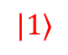
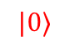
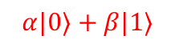
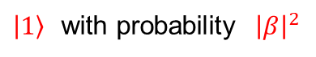
Measurement and qubit collapse
$$|0⟩$$
$|0⟩$ with probability ${\left|α\right|}^{2}$
measurement
$$α|0⟩+β|1⟩$$
$\left|1\right\rangle$ with probability ${\left|β\right|}^{2}$
$$|1⟩$$
Measuring a qubit leads to a random result and affects the qubit irreversibly.
The original state is lost, and no copies can be made (no-cloning theorem).

Slide 8
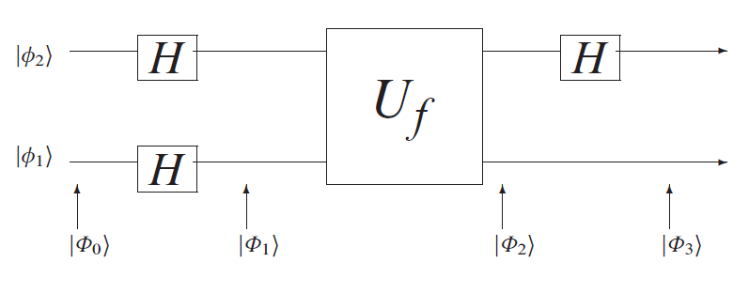
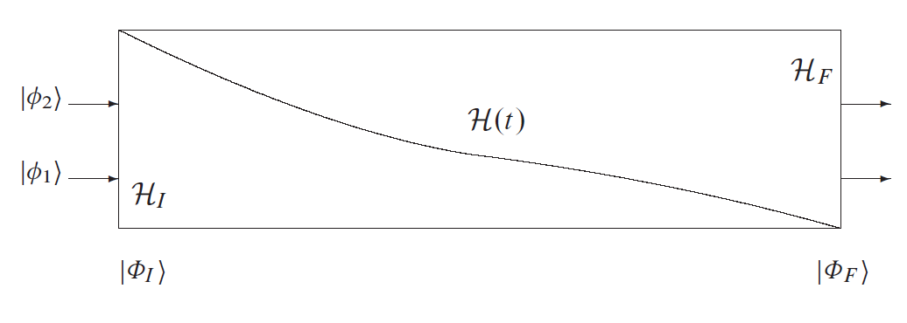
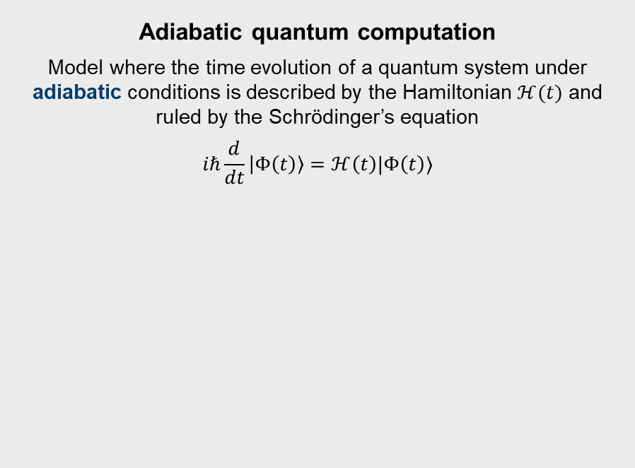
Quantum computational models
Quantum circuit model
Model where quantum gates and measurements are applied to qubits
Adiabatic quantum computation
Model where the time evolution of a quantum system under adiabatic conditions is described by the Hamiltonian $ℋ(t)$ and ruled by the Schrödinger’s equation
$$iℏ\frac{d}{dt}\left|Φ\left(t\right)\right\rangle =ℋ\left(t\right)|Φ\left(t\right)⟩$$
Catherine C. McGeoch, Adiabatic Quantum Computation and Quantum Annealing: Theory and Practice , Morgan & Claypool, 2014.
Catherine C. McGeoch, Adiabatic Quantum Computation and Quantum Annealing: Theory and Practice , Morgan & Claypool, 2014.

Slide 9
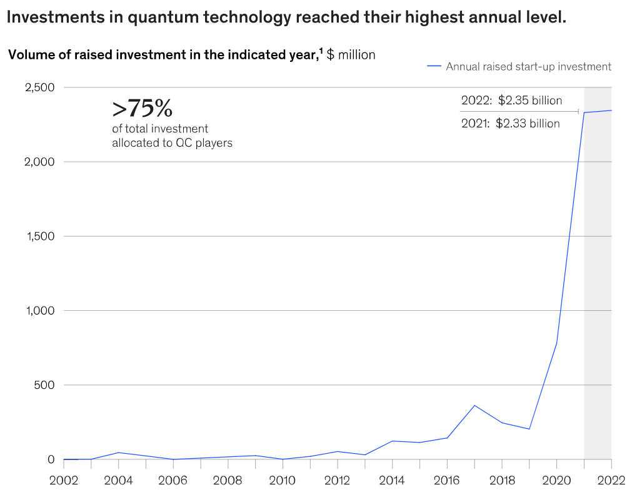
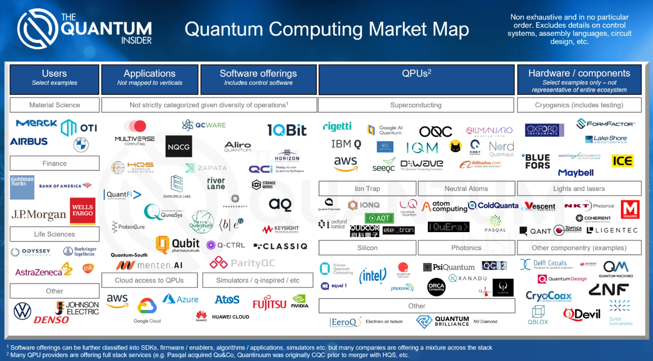
The quantum computing landscape
https://thequantuminsider.com/2022/05/09/quantum-computing-market-map-and-data-2022/
https://www.mckinsey.com/capabilities/mckinsey-digital/our-insights/quantum-technology-sees-record-investments-progress-on-talent-gap

Slide 10
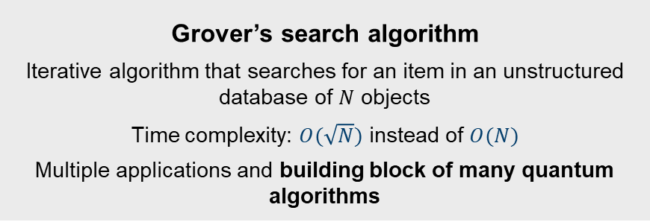
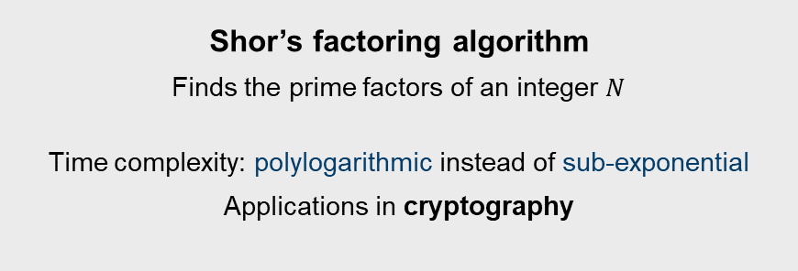
Quantum computing can provide a substantial computational advantage
Grover’s search algorithm
Iterative algorithm that searches for an item in an unstructured database of $N$ objects
Time complexity: $O(\sqrt{N})$ instead of $O(N)$
Multiple applications and building block of many quantum algorithms
Shor’s factoring algorithm
Finds the prime factors of an integer $N$
Time complexity: polylogarithmic instead of sub-exponential
Applications in cryptography

Slide 11
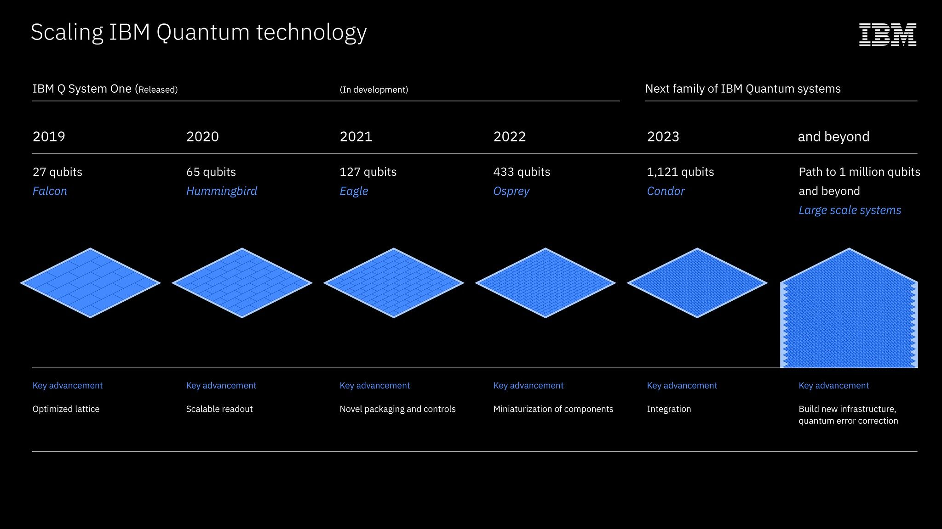
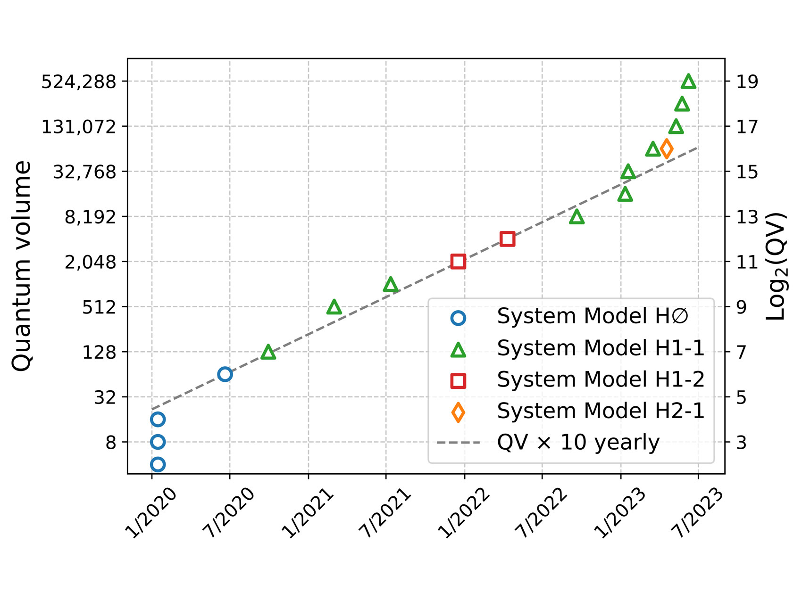
Quantum computers present practical limitations
Quantum information theory neglects physical implementation
Current state: Noisy Intermediate-Scale Quantum (NISQ) devices
Insufficient scale for a practical quantum advantage
Number of qubits
Dimension of quantum data that can be processed in a single QPU
Quantum volume
Dimension of the circuit that can be implemented with low error
https://www.ibm.com/quantum/blog/ibm-quantum-roadmap
https://www.quantinuum.com/news/quantinuum-h-series-quantum-computer-accelerates-through-3-more-performance-records-for-quantum-volume-217-218-and-219

Slide 12
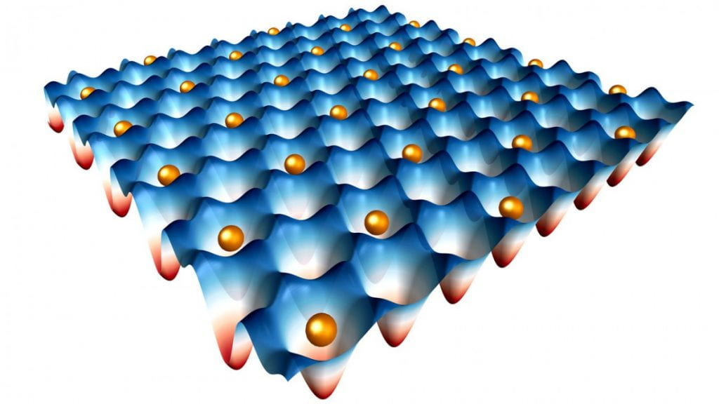
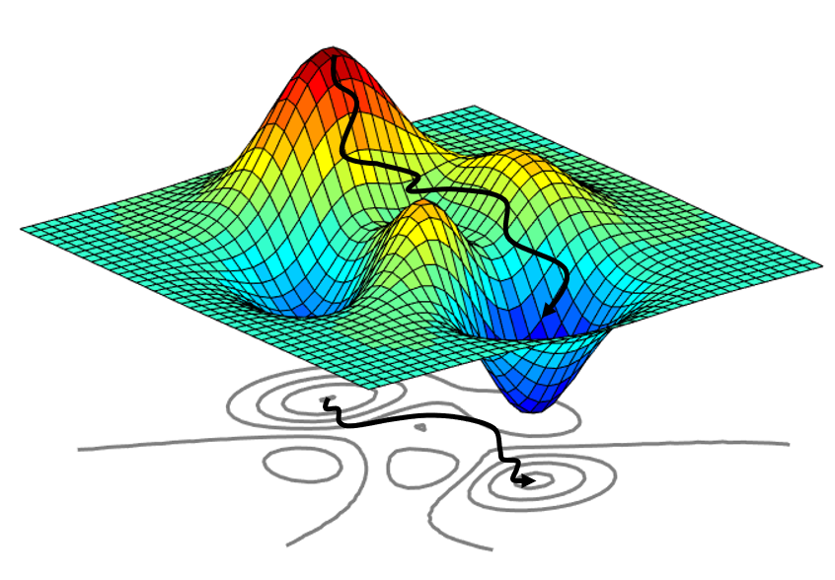
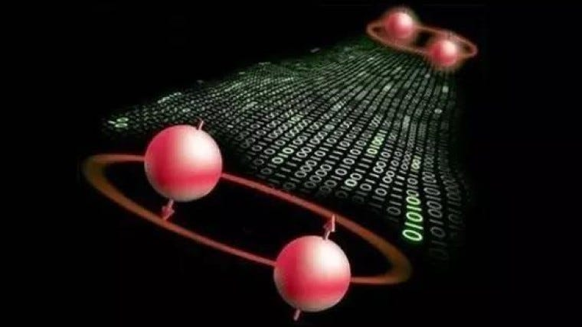
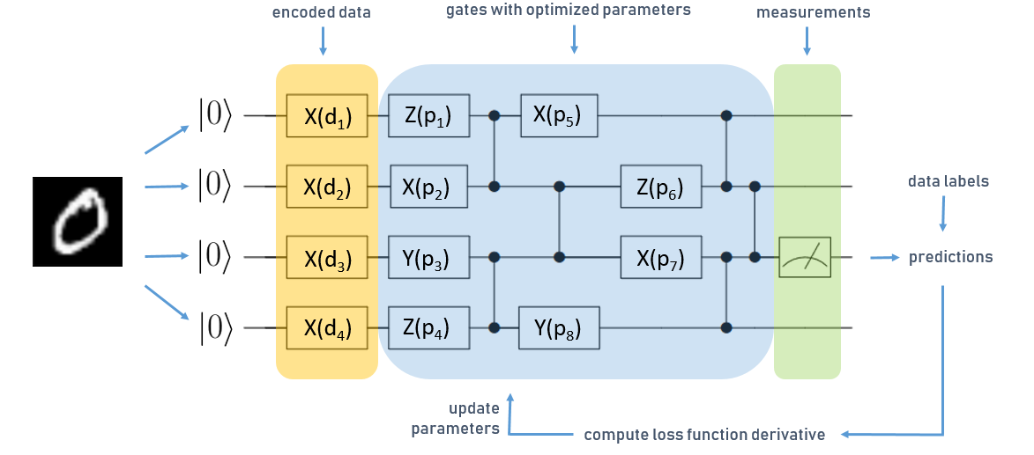
Main applications of quantum computing
Quantum simulation
Quantum optimization
https://quantum.cornell.edu/files/2021/11/quantum_simulation-1024x576.jpg
https://towardsdatascience.com/an-introduction-to-surrogate-optimization-intuition-illustration-case-study-and-the-code-5d9364aed51b
Quantum cryptography
Quantum machine learning
https://miro.medium.com/v2/resize:fit:760/0*ccRjnUb2QLCYTK5a.jpg
https://blog.tensorflow.org/2020/08/layerwise-learning-for-quantum-neural-networks.html
Which are the most relevant for Earth observation?

Slide 13
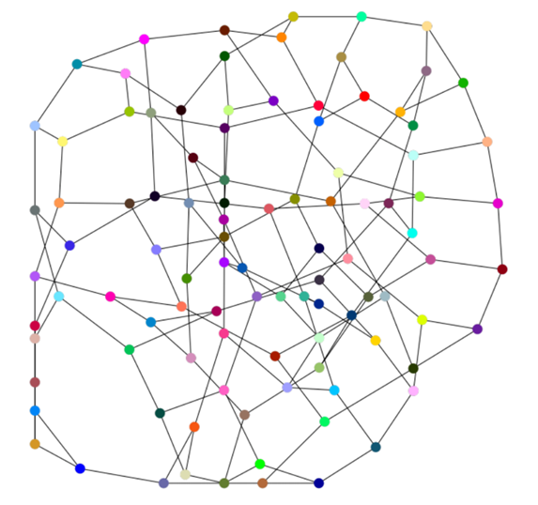
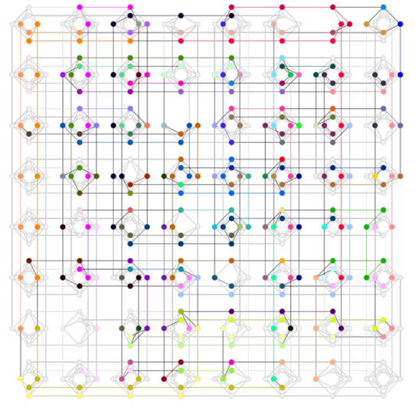
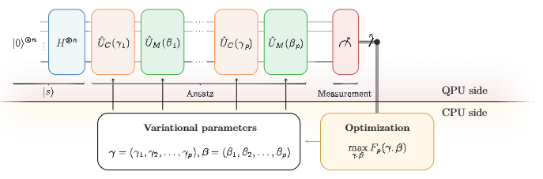
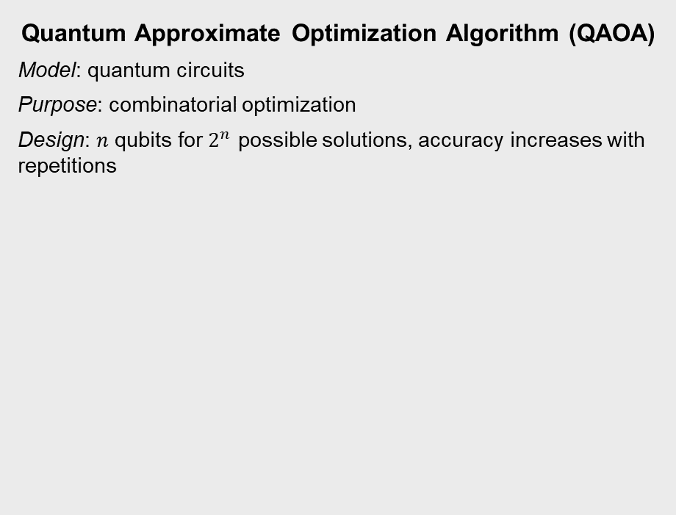
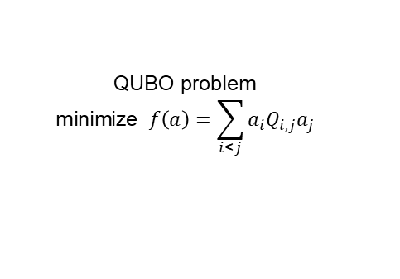
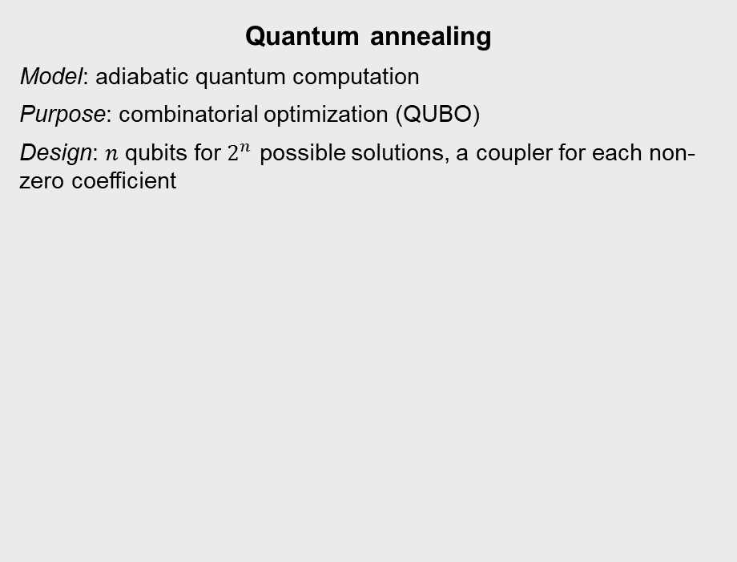
Examples of quantum optimization algorithms
Quantum Approximate Optimization Algorithm (QAOA)
Model: quantum circuits
Purpose: combinatorial optimization
Design: $n$ qubits for $2^{n}$ possible solutions, accuracy increases with repetitions
Quantum annealing
Model: adiabatic quantum computation
Purpose: combinatorial optimization (QUBO)
Design: $n$ qubits for $2^{n}$ possible solutions, a coupler for each non-zero coefficient
embedding
QUBO problem
$$\text{minimize} f\left(a\right)=\sum_{i≤j}{a_{i}Q_{i,j}a_{j}}$$
Hardware graph
Blekos, Kostas, et al. "A review on quantum approximate optimization algorithm and its variants." Physics Reports 1068 (2024): 1-66
Catherine C. McGeoch, Adiabatic Quantum Computation and Quantum Annealing: Theory and Practice , Morgan & Claypool, 2014.

Slide 14
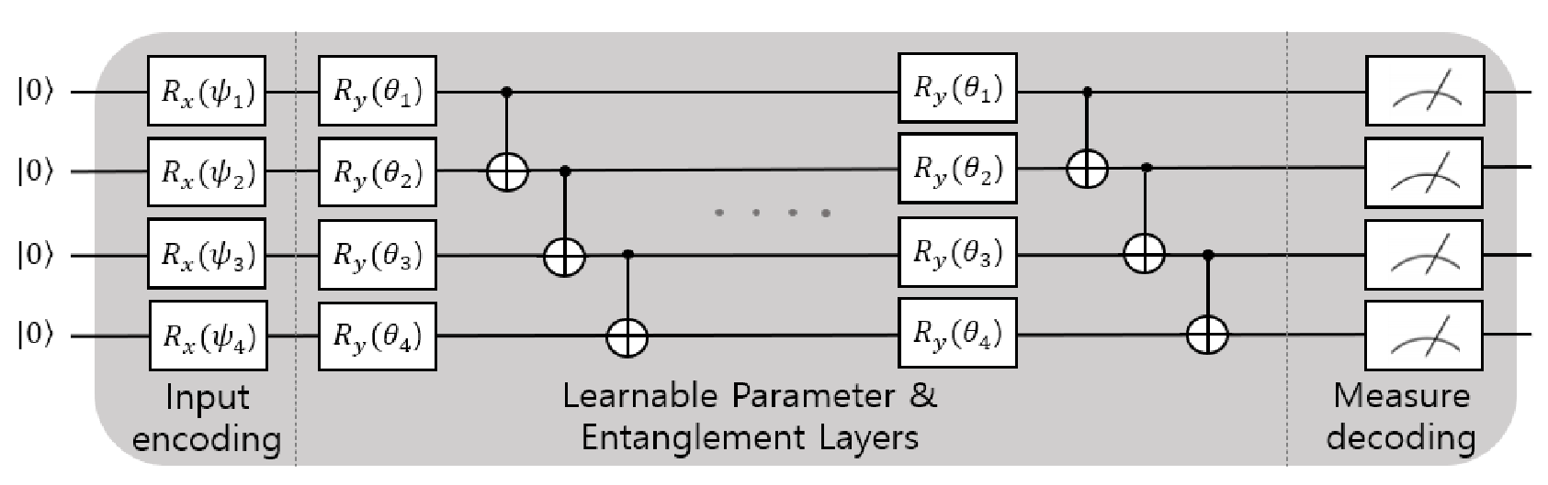
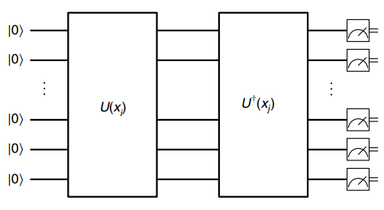
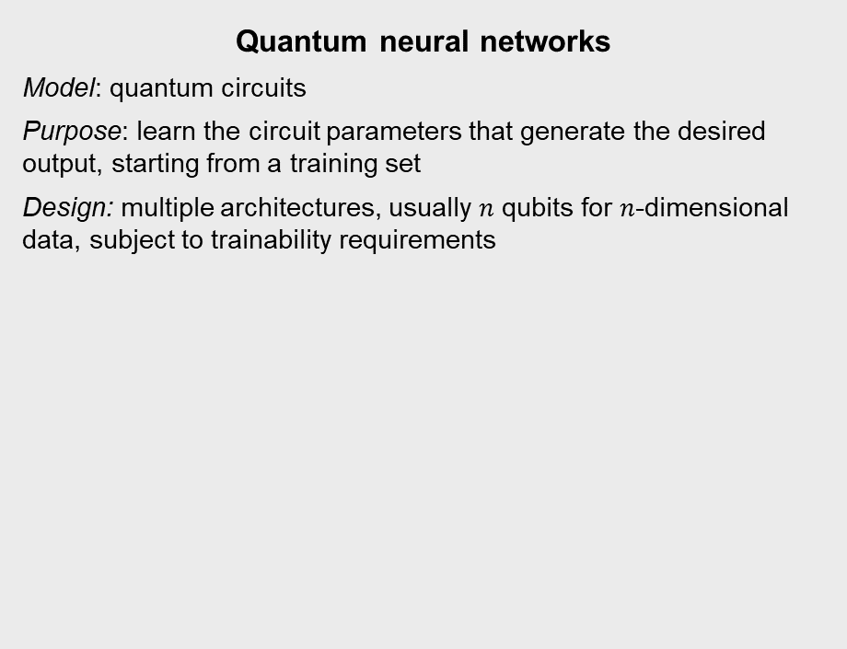
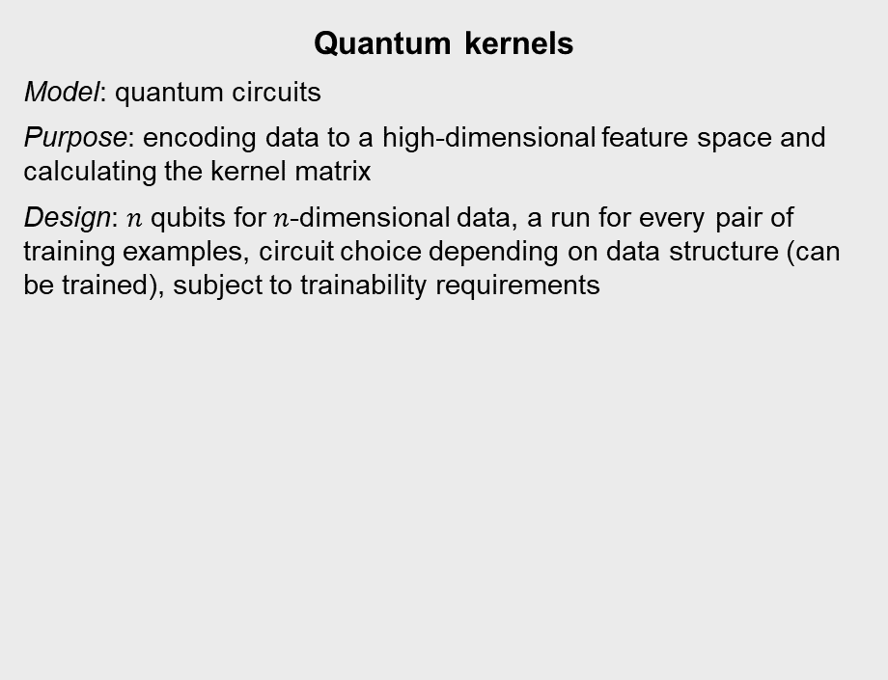
Examples of quantum machine learning algorithms
Quantum neural networks
Model: quantum circuits
Purpose: learn the circuit parameters that generate the desired output, starting from a training set
Design: multiple architectures, usually $n$ qubits for $n$-dimensional data, subject to trainability requirements
Quantum kernels
Model: quantum circuits
Purpose: encoding data to a high-dimensional feature space and calculating the kernel matrix
Design: $n$ qubits for $n$-dimensional data, a run for every pair of training examples, circuit choice depending on data structure (can be trained), subject to trainability requirements
Kwak, Yunseok, et al. "Quantum neural networks: Concepts, applications, and challenges." 2021 Twelfth International Conference on Ubiquitous and Future Networks (ICUFN). IEEE, 2021.
Liu, Yunchao & Arunachalam, Srinivasan, Temme, Kristan. “A rigorous and robust quantum speed-up in supervised machine learning”, Nature Physics, 17, 1-5, 2019.

Slide 15
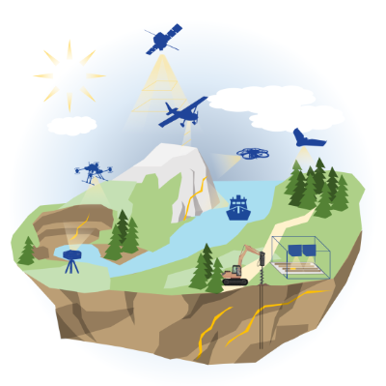
Earth observation requires increasing computing capabilities
https://www.hzdr.de/db/Cms?pOid=45916&pNid=3635

Slide 16
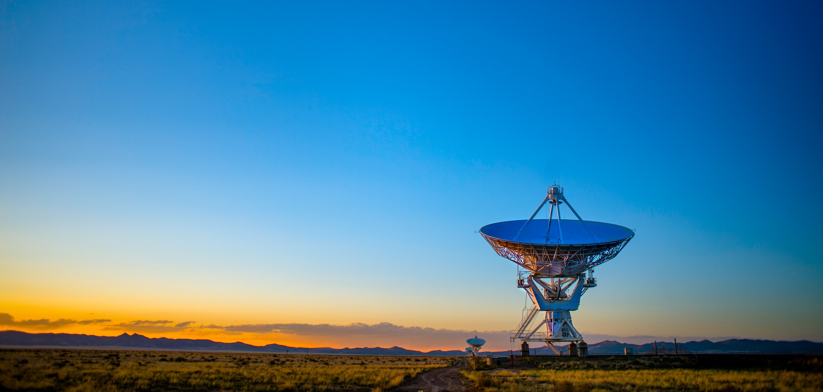



Where does quantum computing fit?
mission analysis
data acquisition
raw data processing
data analysis
Photo by Donald Giannatti on Unsplash
QC4EO Study technical reports: https://eo4society.esa.int/projects/qc4eo-study/

Slide 17
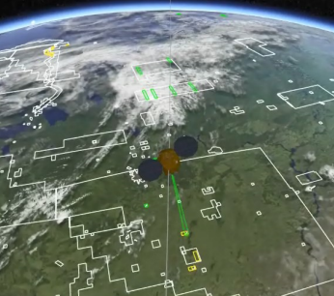
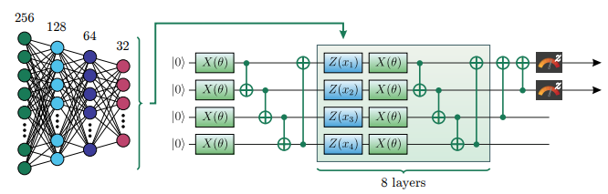
Contributions to quantum computing for Earth observation
Mission
analysis
Acquisition planning for EO satellites
Operational planning of satellite acquisition processes
Data acquisition
Raw data processing
Data
analysis
Rainjonneau, Serge, et al. “Quantum Algorithms applied to Satellite Mission Planning for Earth Observation” submitted to IEEE JOURNAL OF SELECTED TOPICS IN APPLIED EARTH OBSERVATIONS AND REMOTE SENSING (2023) and arXiv preprint arXiv:2302.07181v1 (2023).
Stollenwerk, Tobias, et al. "Image Acquisition Planning for Earth Observation Satellites with a Quantum Annealer." arXiv preprint arXiv:2006.09724 (2020).

Slide 18
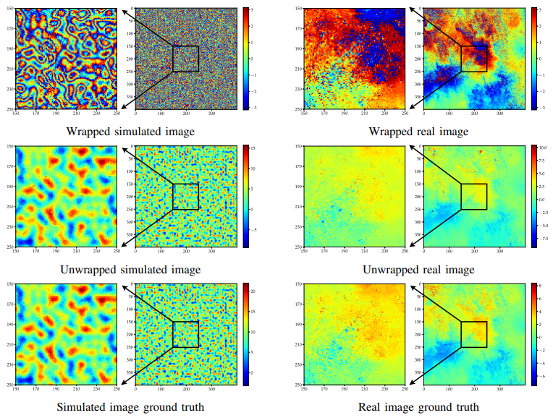
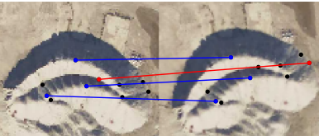
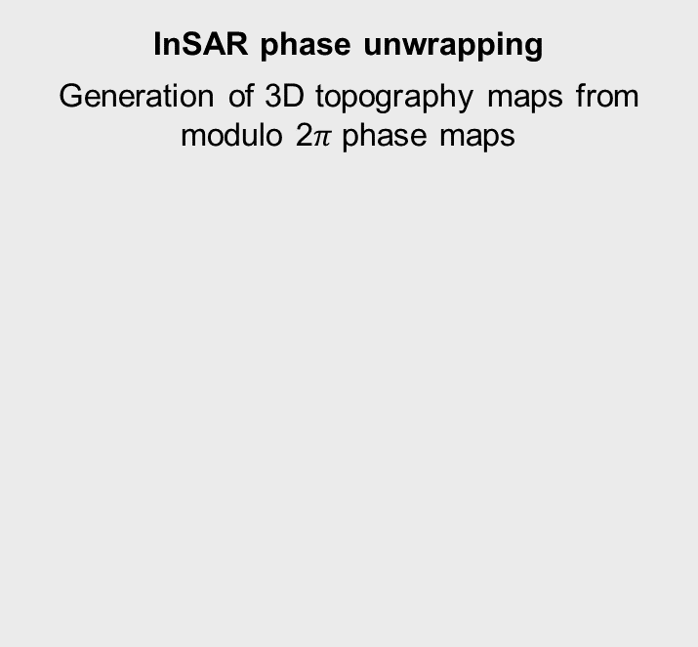
Contributions to quantum computing for Earth observation
Mission
analysis
InSAR phase unwrapping
Generation of 3D topography maps from modulo 2$π$ phase maps
Bundle adjustment
Keypoint extraction and feature matching for data fusion of images taken from different points of view
Data acquisition
Raw data processing
Data
analysis
Nico Piatkowski, Thore Gerlach, Romain Hugues, Rafet Sifa, Christian Bauckhage, Frederic Barbaresco, “Towards Bundle Adjustment for Satellite Imaging via Quantum Machine Learning”, arXiv:2204.11133 (2022).
Kelany, K. A. H., Dimopoulos, N., Adolphs, C. P. J., Barabadi, B., & Baniasadi, A. (n.d.). Quantum Annealing Approaches to the Phase-Unwrapping Problem in Synthetic-Aperture Radar Imaging.

Slide 19
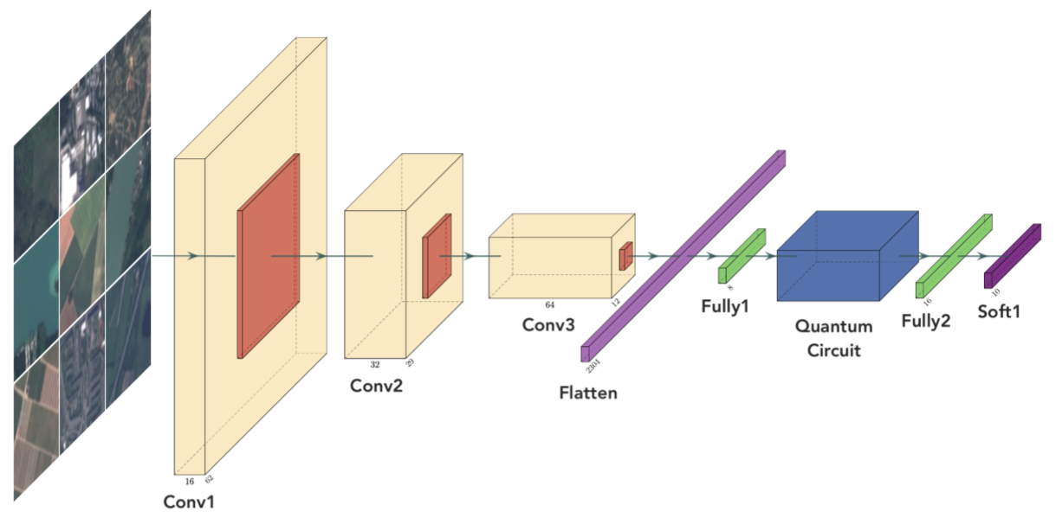
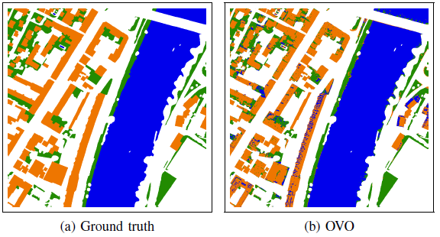
Contributions to quantum computing for Earth observation
Mission
analysis
Event detection
Supervised training of hybrid quantum convolutional neural networks on multispectral image datasets
Semantic segmentation
Supervised pixel-based or region-based kernel methods (quantum kernels, quantum SVM)
Data acquisition
Raw data processing
Data
analysis
A. Sebastianelli, D. A. Zaidenberg, D. Spiller, B. L. Saux, and S. L. Ullo, “On Circuit-Based Hybrid Quantum Neural Networks for Remote Sensing Imagery Classification,” IEEE Journal of Selected Topics in Applied Earth Observations and Remote Sensing, vol. 15, pp. 565–580, 2022.

Slide 20
Practical examples
Acquisition planning for EO satellites
Use case for quantum optimization algorithms (QAOA, QA)
Semantic segmentation of satellite images
Use case for quantum machine learning algorithms
Session “Quantum Approaches in Remote Sensing”

Slide 21
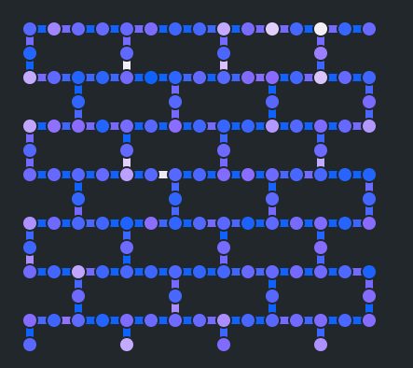
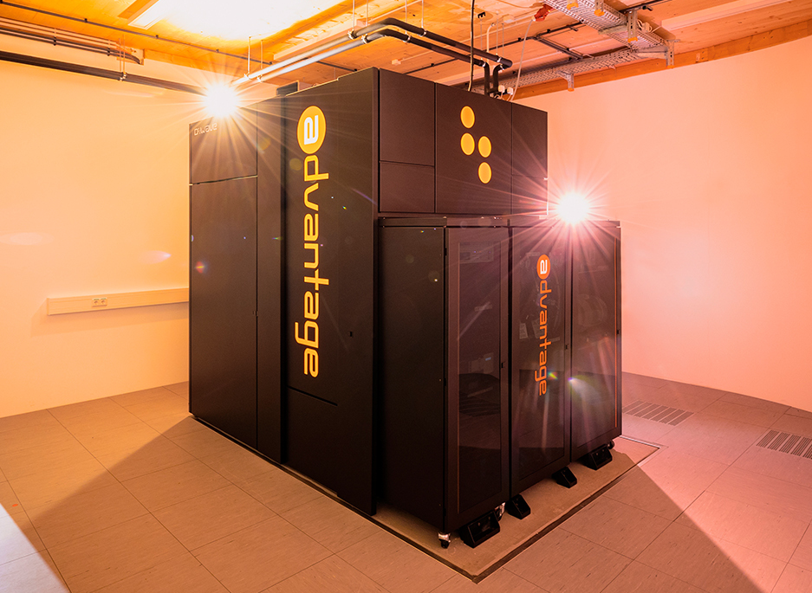
Tools for testing quantum algorithms
Qiskit
Creating and running quantum circuits on multiple backends
Example: IBM Torino: 133 qubits
Free access to QPUs (queue time may vary)
D-Wave Ocean
Creating and solving QUBO optimization problems on multiple backends
Example: D-Wave Advantage quantum annealer: 5000+ qubits
1-min free computing time
https://quantum.ibm.com/
https://www.fz-juelich.de/en/ias/jsc/systems/quantum-computing/juniq-facility
Qubit structure of IBM Torino
JUPSI, a D-Wave Advantage quantum annealer hosted at FZJ

Slide 22
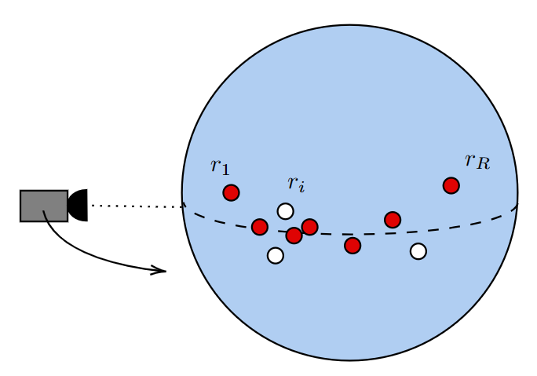
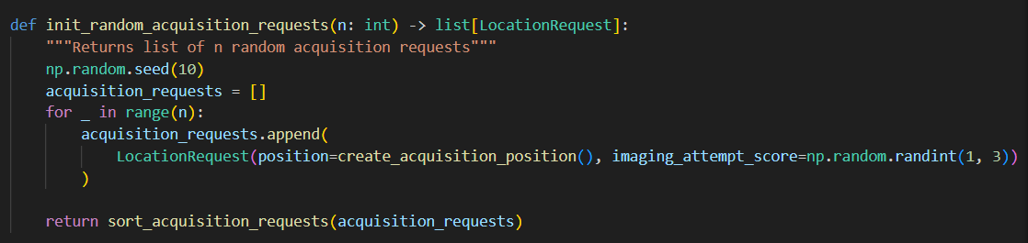
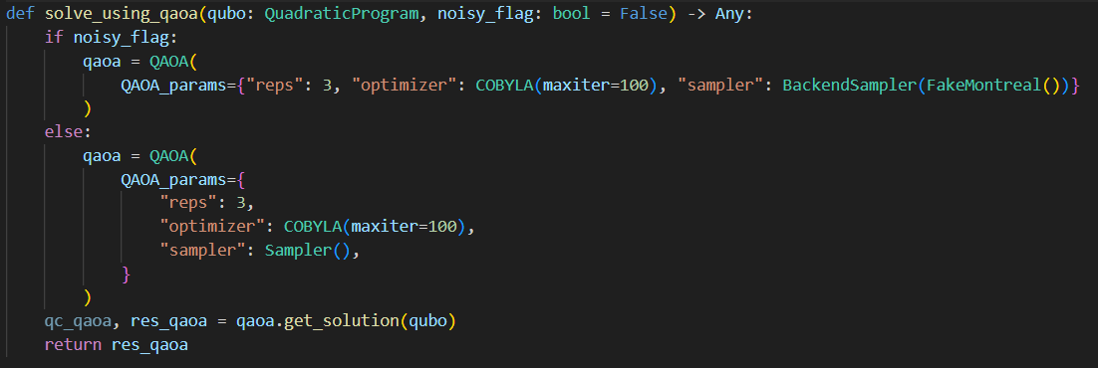
Acquisition planning for EO satellites
mqt-problemsolver: great library for testing QAOA for acquisition planning
Quetschlich, N., Koch, V., Burgholzer, L., & Wille, R. (2023). A Hybrid Classical Quantum Computing Approach to the Satellite Mission Planning Problem. https://arxiv.org/abs/2308.00029v1
Example problem instance

Slide 23
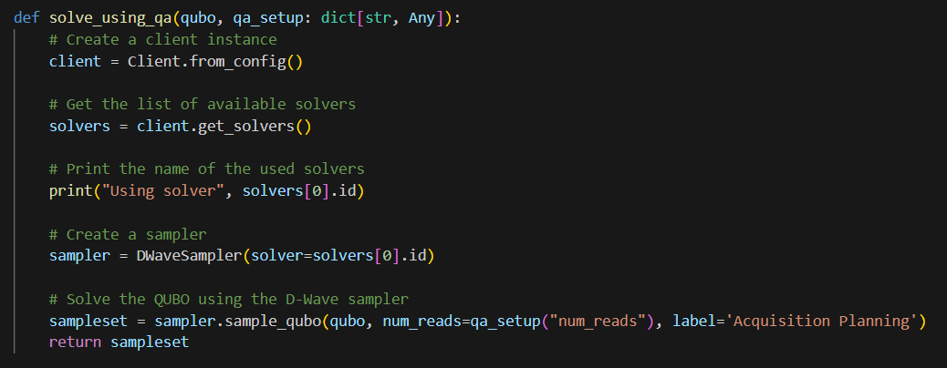
Acquisition planning for EO satellites
Solving QUBO with quantum annealing:
Example problem instance

Slide 24
Conclusions
Multiple tools are available and multiple applications are possible
Testing today: insights on the behavior of quantum algorithms > actual advantage
Fast development of quantum hardware can change the game
Session “Quantum Approaches in Remote Sensing” (tomorrow, 9.30-10.30, in this room)
Quantum neural network for semantic segmentation of radar sounder data: 9.45-10.00
Quantum annealing for semantic segmentation of optical images: 10.15-10.30

Slide 25
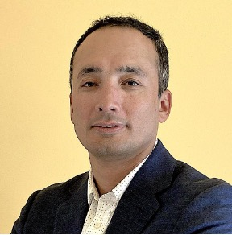






Thanks to GRSS
Join us!
CHAIRS
Earth Science Informatics (ESI) Technical Committee
Advance application of informatics to geoscience and remote sensing
Manil Maskey
Peter Baumann
Gabriele Cavallaro
https://www.grss-ieee.org/technical-committees/earth-science-informatics/
LEADS
High-performance and Disruptive Computing in Remote Sensing (HDCRS) Working Group
Connect and support the community of interdisciplinary researchers in remote sensing who are specialized in emerging computing paradigms
Dora Blanco Heras
Iksha Gurung
Rocco Sedona
Sudan Jha
https://www.grss-ieee.org/community/groups-initiatives/high-performance-and-disruptive-computing-in-remote-sensing-hdcrs/
G. Cavallaro, D. B. Heras, Z. Wu, M.Maskey, S. Lopez, P. Gawron, M. Coca and M. Datcu, "High-Performance andDisruptive Computing in Remote Sensing: HDCRS-A New Working Group of the
GRSS Earth Science Informatics Technical Committee," in IEEE Geoscience and Remote Sensing Magazine (GRSM), vol. 10, no. 2, 2022, https://doi.org/10.1109/MGRS.2022.3145478‍
Upcoming event:
School on High Performance and Disruptive Computing in Remote Sensing
4-7 June 2024, Santiago de Compostela, Spain (https://www.hdc-rs.com/)
Notes:
I would like to thank GRSS, in particular the HDCRS working group, which is part of the IEEE GRSS Earth Science Informatics (ESI) Technical Committee
This tutorial is one of the main activities of HDCRS
The main objective of HDCRS is to connect a community of interdisciplinary researchers in remote sensing who are specialized on high-performance and distributed computing, quantum computing and parallel programming models with specialized hardware accelerators. HDCRS disseminates information and knowledge through educational events, special sessions and tutorials at conferences and publication activities.
Main upcoming event is the School on High Performance and Disruptive Computing in Remote Sensing 4-7 June 2024, Santiago de Compostela, Spain
Unfortunately the registration is closed, and it is only an only in person event. However, all lectures will be uploaded to the GRSS YouTube channel after the event (as for previous editions)
The HDCRS working group welcomes anyone interested from academia and industry to contribute to our mission. Please join us

Slide 26


Questions?
Amer Delilbasic Doctoral Researcher @ Jülich Supercomputing Centre, Germany & University of Iceland
a.delilbasic@fz-juelich.de
linkedin.com/in/delilbasic
Gabriele Cavallaro Head of Simulation and Data Lab @ Jülich Supercomputing Centre & Adjunct Associate Professor @ University of Iceland
g.cavallaro@fz-juelich.de
gabriele-cavallaro.com

